Slide 1


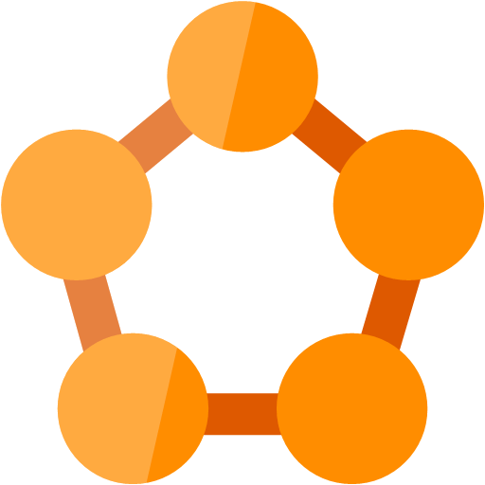
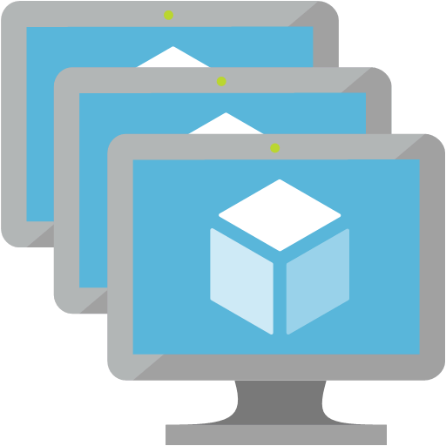






Front Door
Internet
End Users
Service Fabric Cluster
Service Fabric Cluster
Jump box VM
Docker Hub
Availability Zones
Availability Zones
Azure DevOps
Jenkins
(Azure Region – South East Asia)
Geo-replicated, Multi Region Write
(Azure Region – East US 2)
Cosmos DB
Cosmos DB

Slide 2
